Slide 1
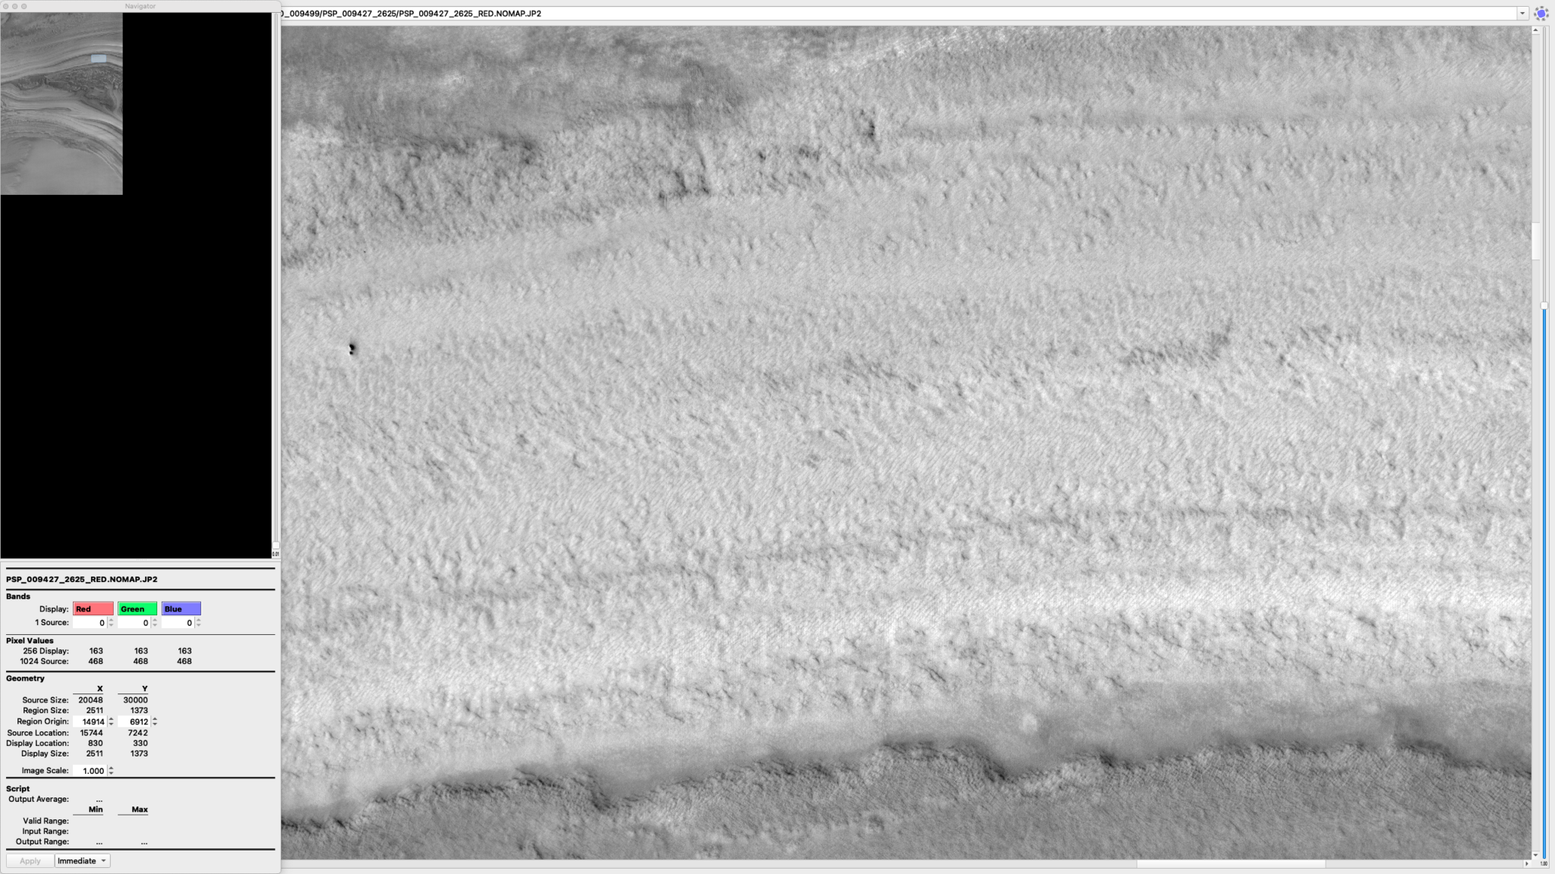
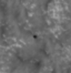
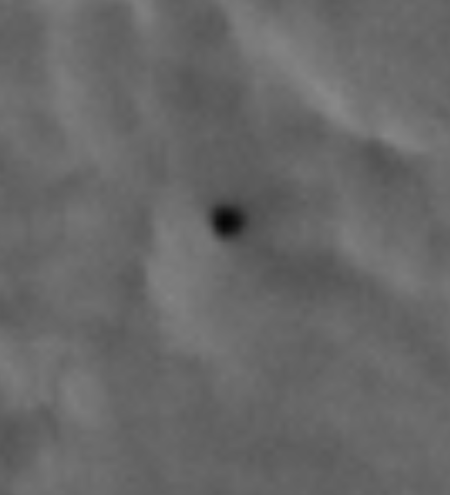
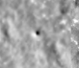
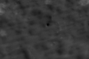
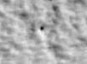
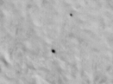




1
Investigating Enigmatic Pits in the North Polar Layered Deposits of Mars
1.5m
PSP_009427_2625
ESP_036776_2620
Dora Elalaoui-Pinedo
Dr. Sarah Sutton
Lunar and Planetary Laboratory, HiRISE, University of Arizona
University of Arizona
April 19, 2025
1.3m
ESP_036776_2620
All images from: uahirise.org

Slide 2
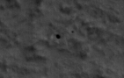
The Polar Pits
2
1.5m
Meter-sized, quasi-circular, deeply shadowed pits of unknown origin appear in the troughs of the North Polar Layered Deposits (NPLD) and appear linearly in the North Residual Cap (NRC) of Mars.
Using High Resolution Imaging Science Experiment (HiRISE) images aboard the NASA Mars Reconnaissance Orbiter, I located and mapped ~2,000 pits.
Currently, I am conducting a change detection analysis using HiRISE images of pits over several Mars Years (MY) to understand their possible formation and seasonal changes.
Analyzing changes can constrain rates of active surface processes in the NPLD, potential faults, and sublimation or deposition of ice.
1.3m
2.5m
2.5m
ESP_036776_2620
PSP_007373_2615
PSP_007373_2615
PSP_007225_2620
PSP_007225_2620
ESP_045231_2610
All images from: uahirise.org
ESP_045231_2610

Slide 3
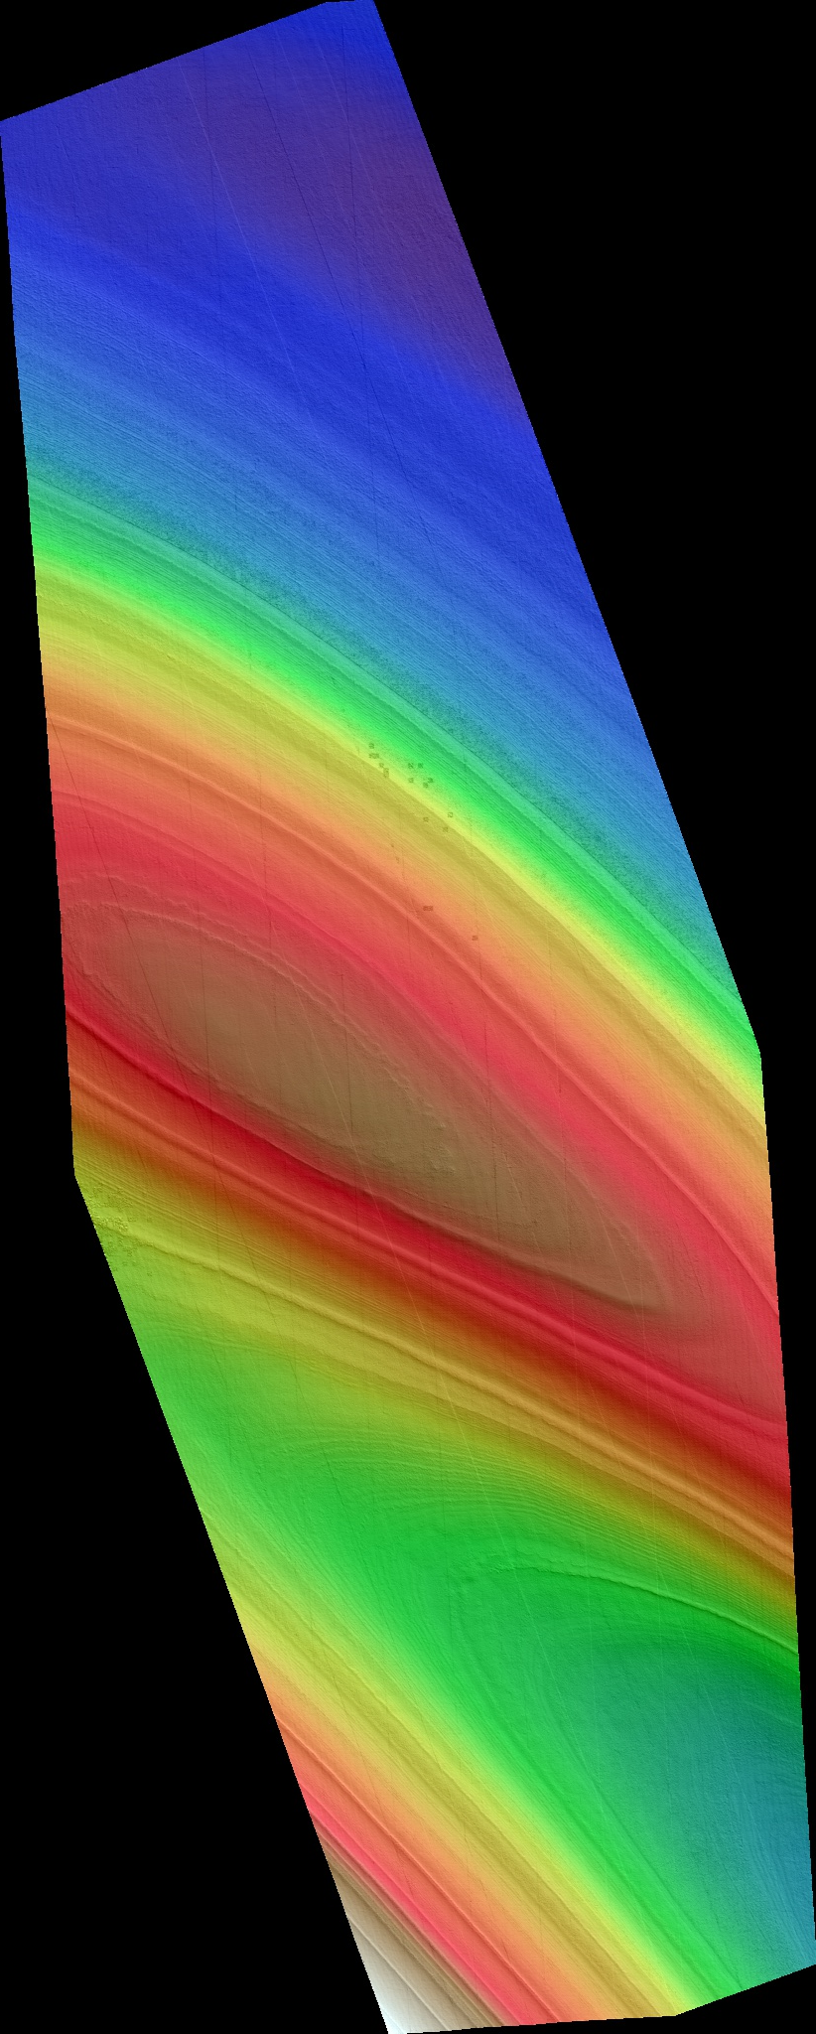
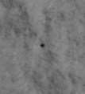
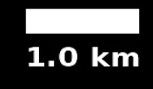
Analyzing Pit Changes
3
1.5m
We can view images taken in the same and different seasons for seasonal comparisons.
We can make Digital Terrain Models (DTMs) of areas with pits in the NPLD and NRC to further monitor possible changes.
Using stereo images, the DTM, and monitoring images, we can perfectly line up images taken at different times and angles to measure changes accurately.
1.3m
2.5m
ESP_036776_2620
All images from: uahirise.org

Slide 4
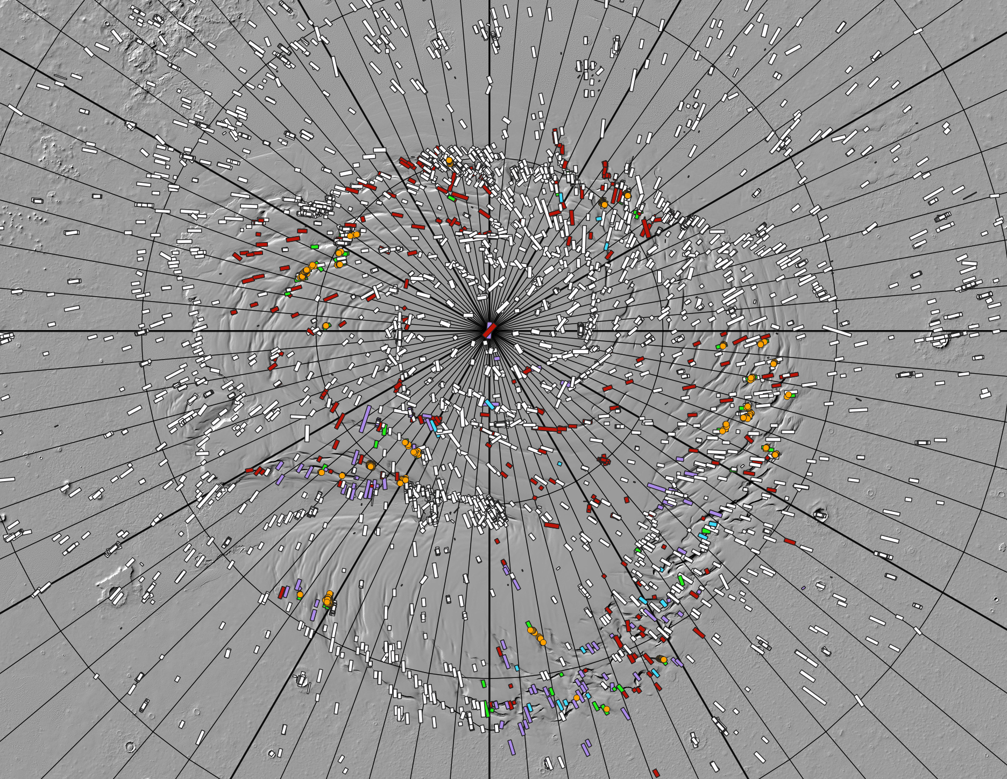
Map of the North Polar Region of Mars
210°
180°
150°
4
120°
240°
HiRISE image footprints are color-coded polygons.
Circled areas indicate sites that were monitored for the change detection analysis.
270°
90°
pits found
pits not found
possible pits
Bin 2 images
pit locations
NRC pits
not viewed
300°
60°
330°
0°
30°

Slide 5
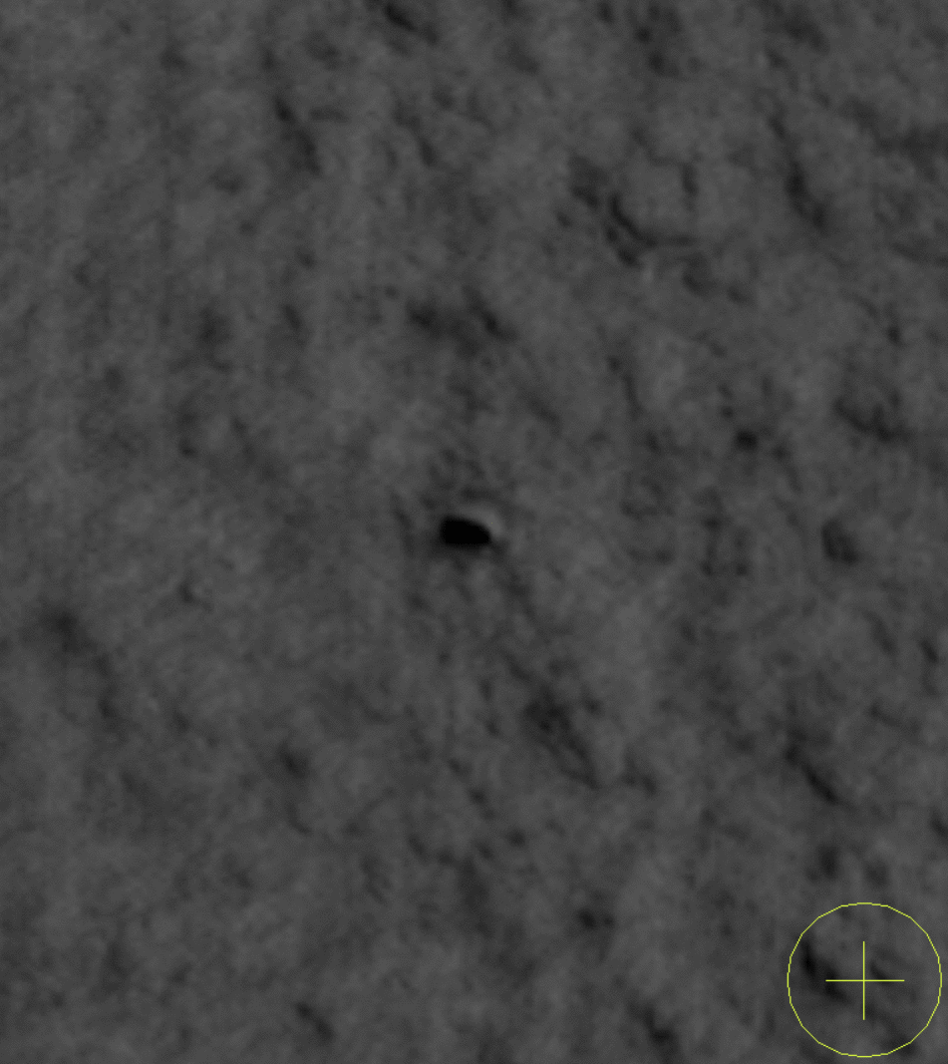
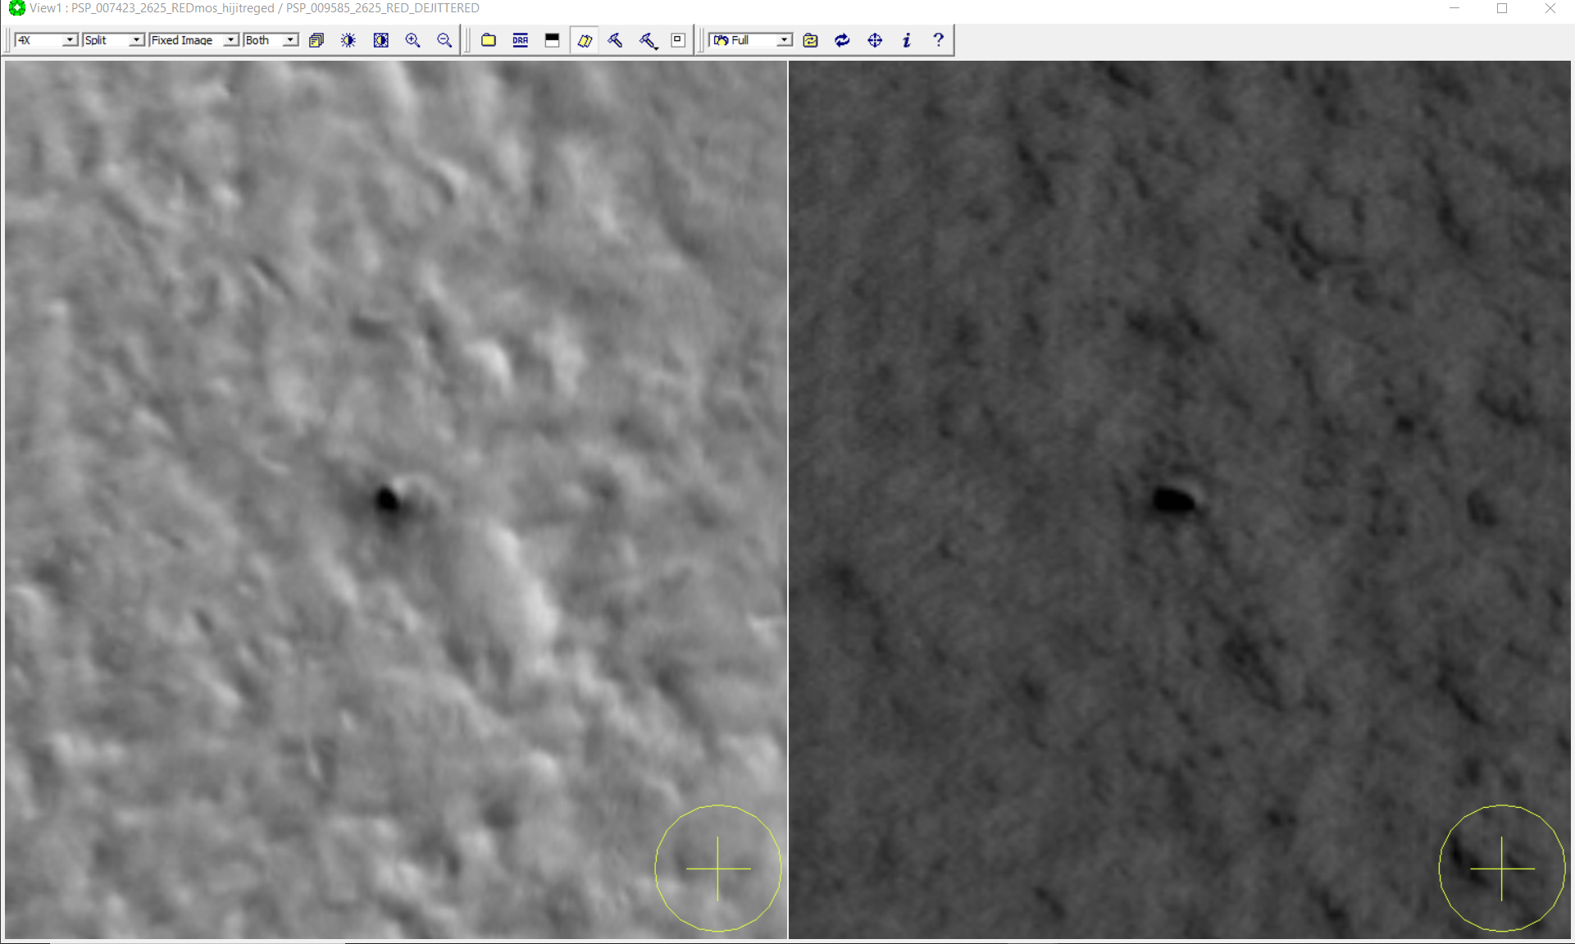
Monitoring Site "Boots"
5
Same Mars Year, different seasons.
Pit is seen in the wall of a trough in the NPLD.
We see the apparent diameter of this pit enlarge during the summer season → this could be due to frost sublimation on the rim of the pit.
MY 29
Ls 37°
Spring (frost-covered)
MY 29
Ls 111°
Summer (frost-free)
10 m
10 m
10 m

Slide 6
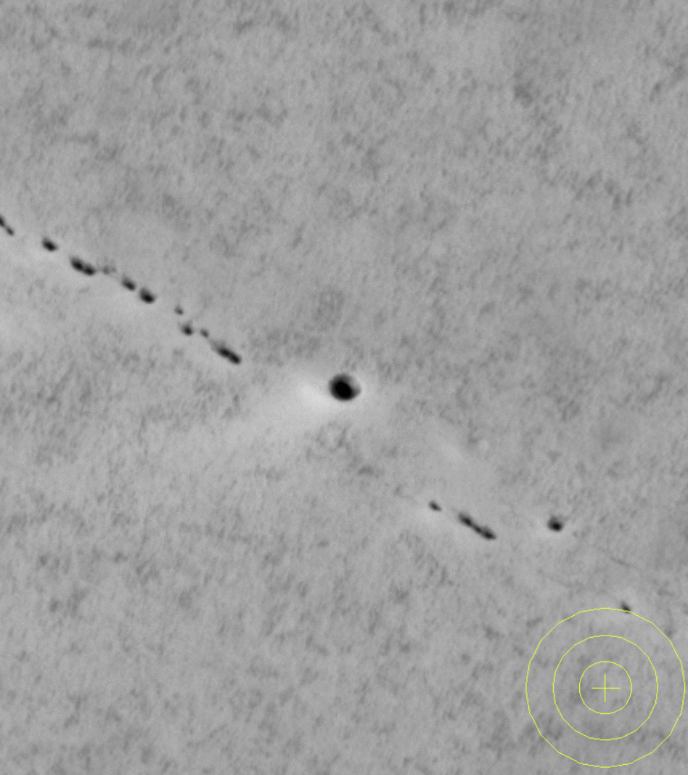

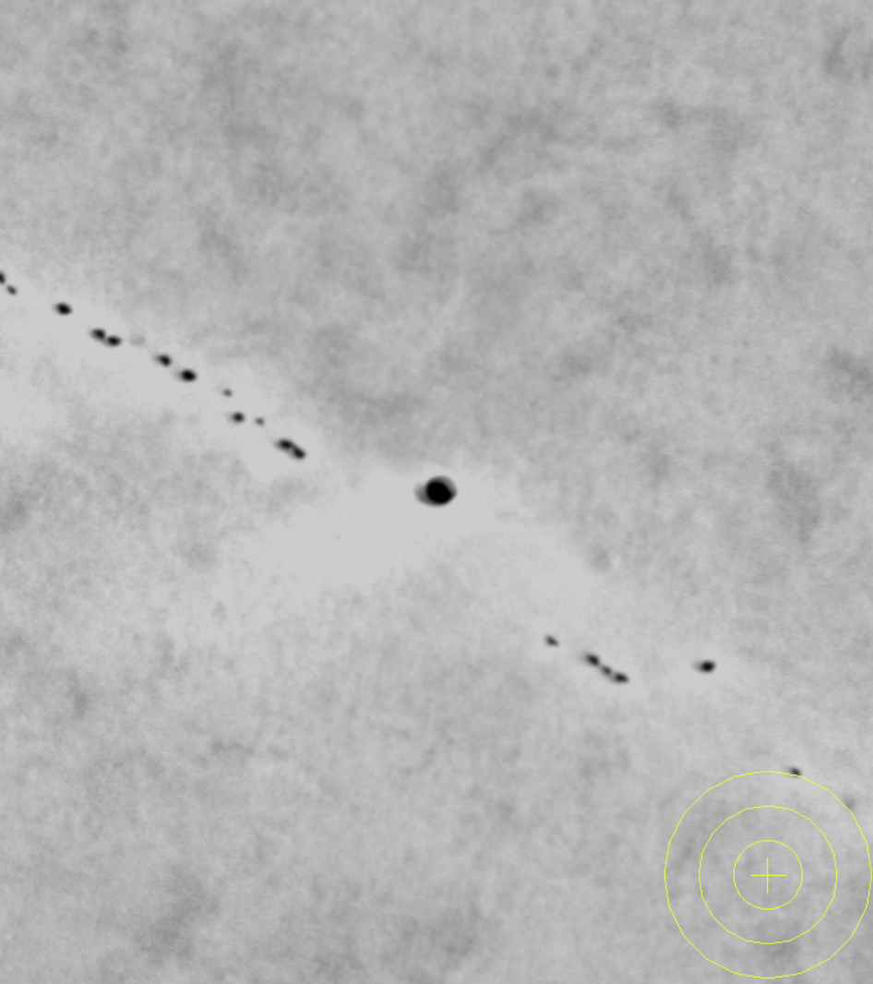
Monitoring Site "Okubo Fault One"
6
Over 8 Mars Years at this site, we see no new pits and no apparent significant changes.
Pits have remained in the same location for 8 MY.
Apparent change on surface is frost-related.
NRC Pits could be fault-related, but fault could be inactive.
MY 29
Ls 120°
Summer
MY 37
Ls 119°
Summer
10 m
10 m
10 m

Slide 7
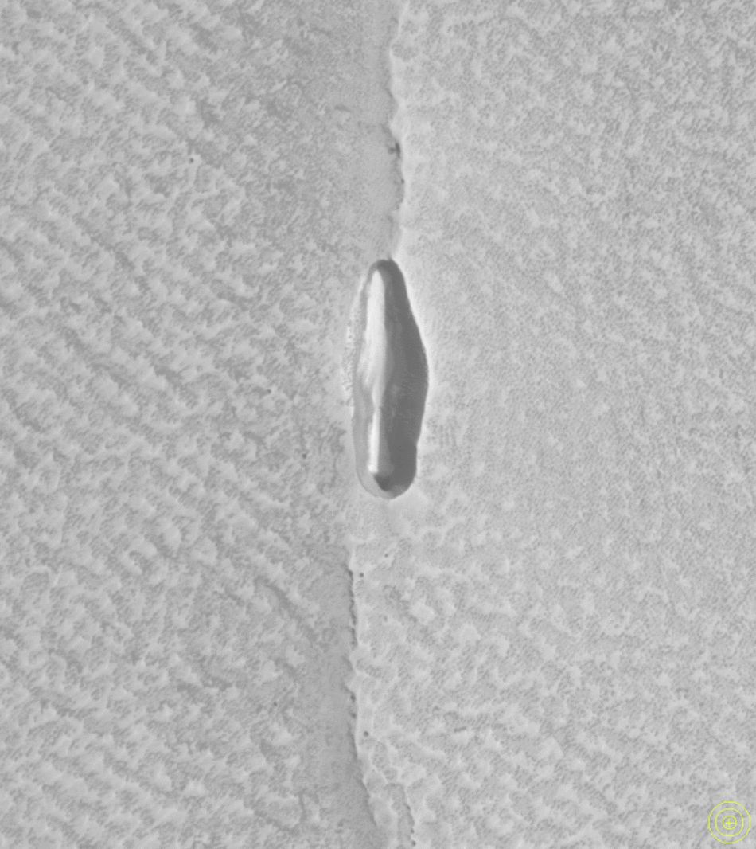
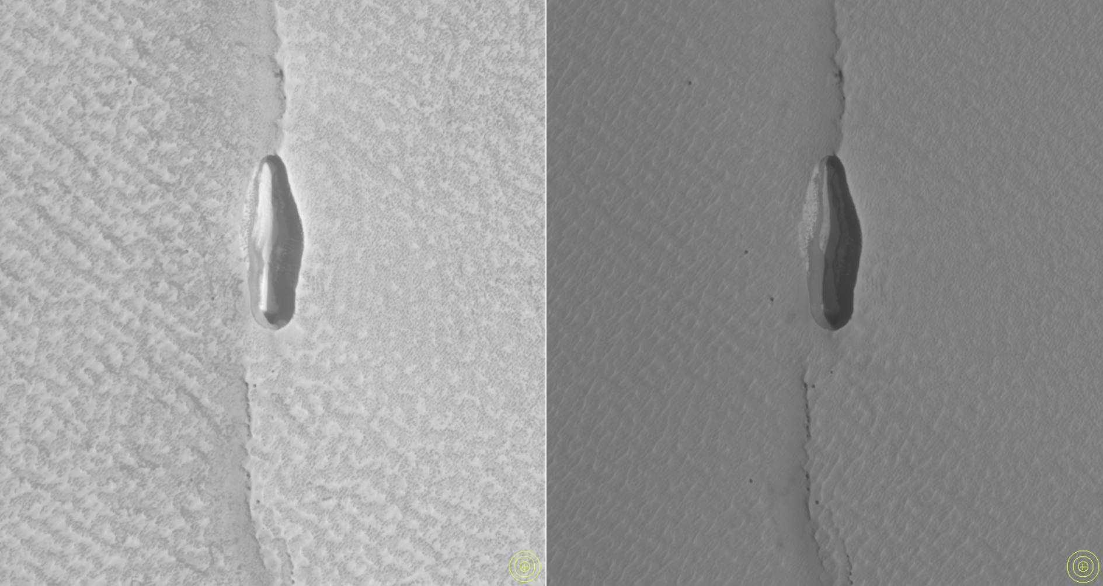
Monitoring Site "Okubo Fault Two"
7
Over 5 Mars Years at this site, we see no new pits and no apparent significant changes.
Pits have remained in the same location for 5 MY.
Frost-related changes are apparent inside of larger pit and on surface.
NRC pits could be fault-related, but fault could be inactive.
MY 30
Ls 127°
Summer
MY 35
Ls 138°
Summer
30 m
30 m
30 m

Slide 8
8
Preliminary Results
Future Directions
1.5m
Discovery of three new locations of possible fault-related pits.
New pits are not actively forming in the images analyzed.
Pits are not apparently changing.
Rims of pits could be changing due to seasonal processes, like sublimation or deposition of ice.
Pits could be gradually forming over a longer timespan than timespans analyzed.
Pits could have formed suddenly in the past and now are stable.
Do pits occur on equator-facing slopes or pole-facing slopes?
Minimum depth calculations using sun incidence angle.
Specific measurements of pits (size, aspect, etc.)
Are pits found in specific layers throughout the NPLD?
Can trends in aspect point to wind, insolation, and erosion formation processes?
Confirming frost-related changes.
PSP_009427_2625
1.3m
2.5m
ESP_036776_2620
PSP_007225_2620
All images from: uahirise.org

Slide 9
Acknowledgements
9
1.5m
PSP_009427_2625
Dr. Sarah Sutton 👏👏
The HiRISE Team
Lunar and Planetary Laboratory
The University of Arizona
NASA Arizona Space Grant
1.3m
PSP_007608_2630
ESP_036776_2620
ESP_045231_2610
ESP_045231_2610
PSP_007373_2615
All images from: uahirise.org

Slide 10
10
1.5m
PSP_009427_2625
Thank you!
1.3m
Dora Elalaoui-Pinedo
delisaeap@arizona.edu
PSP_007608_2630
ESP_036776_2620
ESP_045231_2610
ESP_045231_2610
PSP_007373_2615
All images from: uahirise.org

